Slide 1


Slide 2
THIN SEAM MINING
The definition of thin seam varies considerably against coal mining countries. There are, however, fairly well defined minimum thickness in which equipment can work.
Underground mining of thin seam has invariably been more difficult, hazardous and costly process than working of thicker seam.

Slide 3
In thick seam mines the support provided are effective (better for L/w than in B&P) but in thin seam the vertical space for men to work or travel is restricted. Thus there is a need to develop manless system in thin seam basically for 2 reasons:
i) to reduce accident potential to zero
ii)because in thin seam it may be impossible for men to operate.

Slide 4
Elements of the Longwall Mining System
In conditions where roof control is difficult, the coal of significant lateral extent, and of sufficient thickness, longwall mining is preferred.
Longwall mining offers the benefits of enhanced safety due to its system of face supports that cover the entire working face.
This method also allows higher extraction ratios, conserving valuable coal reserves.
Some other advantages of this system are its flexibility in dealing with greater mining depths, multiple seams, and a significant reduction in roof bolting.

Slide 5
Problem with longwall mining
The high capital cost of the required equipment.
Interruptions to production can have a serious economic impact whether
They are short term such as starting and stopping the shearer, or longer term as longwall equipment is moved from a depleted section to a new panel.
There may be problems with gas well location, seam thickness, and in soft floor and roof.

Slide 6
System being impractical beneath thick strong roof beds, due the size and cost of the required roof support as well as difficulties in controlled caving.
Because of the areal extent required by a longwall section, variabilities in the seam thickness, roof and floor conditions, local faulting and the presence of wells can also limit the potential of this method.

Slide 7
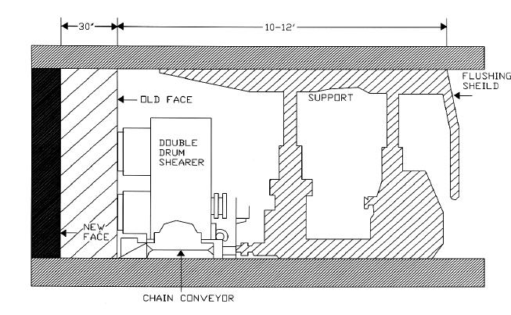
Longwall Face Section with Conventional Double-Drum Shearer

Slide 8
Longwall coal plough
The coal plough replaces the shearer in a typical longwall setup.
The coal plough can mine coal as thin as 18 inches, but beneath 30 inches currently available powered supports cannot be employed, greatly reducing the productivity of the system.
The primary mechanism of the plough is the armored face conveyor that has two main functions, to transport coal away from the face and to guide the plough unit on the face during mining.

Slide 9
PROBLEMS WITH THE PLOUGH SYSTEM
Plough cutting into softer floors and deviating from the desired horizon.
The plough also has difficulties in seams where the coal hardness is not reasonably constant across the face.
The feasibility of this system is questionable in seams less than 24 inches in thickness.

Slide 10
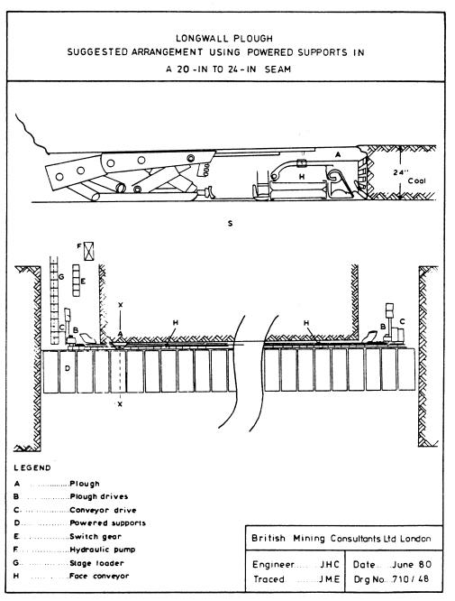

Slide 11
Elements of the Room and Pillar Mining System
Coal is removed from the working faces as the rooms are advanced.
Cross-cuts, connecting the rooms are also mined leaving pillars of coal for support.
Cross-cuts, connecting the rooms are also mined leaving pillars of coal for support.
The conventional room and pillar method of undercutting the coal, drilling, blasting, and loading has largely been supplanted by continuous mining machines that combine the processes of fragmenting the coal from the face and loading it on to haulage equipment for movement to the main coal transportation system.

Slide 12
This has greatly reduced the equipment needed to conduct room and pillar mining.
The process is now simplified, using only a continuous miner, a means of haulage, and a roof bolter.

Slide 13
Bord and pillar layout
The production section is usually composed of either five or seven entries, employing split ventilation.
This means that fresh air is brought in through the central entry or entries and is split and directed across the working face.
The return air is taken down the outermost entries and out of the mine.
The entries are usually of the order of 20 ft in width.
The depth of the overburden determines the size of the support pillars.
The cut sequence is determined by pillar size, cut length, and number of entries.

Slide 14
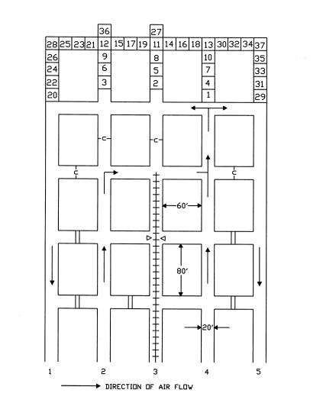
Bord and pillar mining layout

Slide 15
The most commonly employed type of continuous miner is the milling head miner.
This type of miner has a rotating drum that rips the coal from the seam.
The fallen coal is then collected by gathering arms and moved toward the back of the miner by an onboard chain conveyor.
This conveyor runs up an adjustable boom that is used to load a shuttle car, which carries the coal to the main belt.
A typical system uses two shuttle cars traveling sequentially between the continuous miner and the loading point on to a belt conveyor.

Slide 16
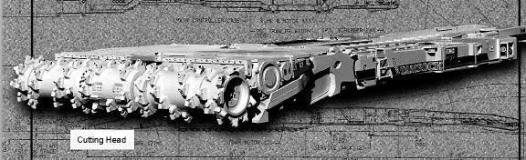
Continuous Miner

Slide 17
In most current room and pillar systems, the coal is transported by shuttle cars from the continuous miner to a feeder breaker which, in turn, loads on to a section conveyor.
A shuttle car is effectively a mobile bunker with a built in steel conveyor for the purpose of loading and unloading.
Shuttle car traffic is controlled to increase both loading time and mining efficiency.
Scheduling the positions of all mobile equipment is very important to the efficient operation of a continuous miner section.

Slide 18
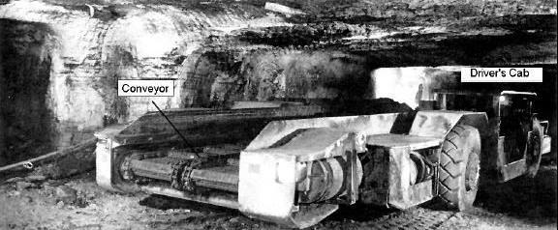
Shuttle car

Slide 19
INTEGRATED MINING AND HAULAGE SYSTEMS
The “Archveyor” Automated Mining and Continuous Haulage Unit
The Long-Airdox Full Dimension Continuous Haulage System

Slide 20
The “Archveyor” Automated Mining and Continuous Haulage Unit
The Archveyor is a long flexible chain conveyor that was developed by Arch Technology, a subsidiary of Arch Coal, Inc.
It has been used in conjunction with a continuous miner to mine in both highwall and underground environments.

Slide 21
Working of Archveyor
The mining sequence for this type of setup is relatively simple.
The continuous miner begins a cut and off loads onto the Archveyor. At this time the Archveyor is in conveyor mode, with its hydraulic jacks lifting it off the ground allowing the conveyor to turn.
As the miner advances to the point whereits boom is almost out of range of the Archveyor, the miner begins to cut upward in the seam allowing coal to collect at the foot of the face until the Archveyor is advanced forward.

Slide 22
While this is occurring, the Archveyor moves its load farther down its length towards the tail end.
Then the hydraulic jacks are retracted and the conveyor rests on its return flights.
By running the conveyor in the opposite direction, the Archveyor is propelled forward.
The jacks are extended again, and the cycle recommences

Slide 23
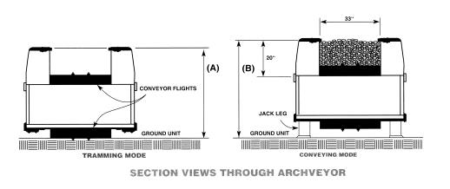

Slide 24
The Long-Airdox Full Dimension Continuous Haulage System
The system contains three main components that are utilized together to transport the coal.
These components include the inby mobile bridge carrier, the intermediate mobile bridge carrier, and the piggyback bridge conveyor.
The inby mobile bridge carrier is fed by a continuous miner and dumps into the first piggyback bridge conveyor. This conveyor dumps into the intermediate mobile bridge carrier, which off-loads into the second piggyback bridge conveyor. This bridge conveyor empties onto the haulage belt of the section.
The flexibility of the system allows the configuration to be adapted to specific layouts.

Slide 25
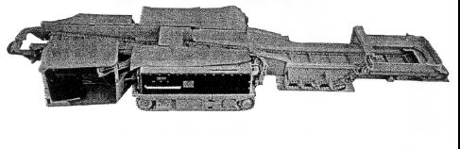
Inby Mobile Bridge Conveyor

Slide 26
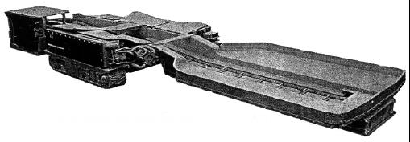
Intermediate Mobile Bridge Conveyor

Slide 27
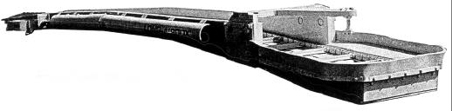
Piggyback Bridge Conveyor

Slide 28
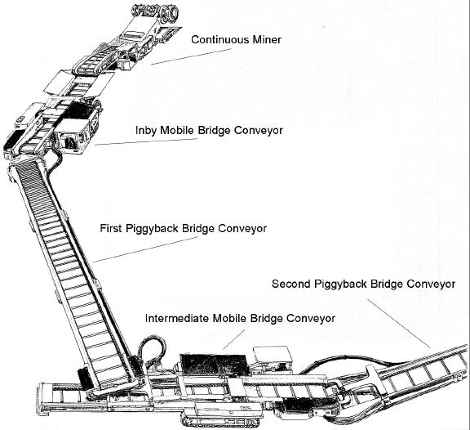
Assembled Continuous Haulage System

Slide 29
AUTONOMOUS MINING MACHINES
Any future system of underground mining of thin seams must be completely automated and operate
without the presence of personnel actually on the working face. This is a prerequisite, not only because of the
limited height of the faces but also to maintain the costs of mining at a competitive level. It is also an
unfortunate fact of geology that coal seams seldom lie in a flat uniform plane of constant thickness. For these
reasons, mining equipment designed to cut and remove coal from thin seams must be autonomous; that is, it
must have a significant degree of artificial intelligence in order to navigate minor anomalies in geology or
obstacles along the coal haulage routes.

Slide 30
One necessary component of any automated coal mining method is seam-following technology.
This is usually achieved through detecting the coal-rock interface at the boundary of the seam.
This has been abbreviated to CID for coal-rock interface detection.
There are numerous types of CID technology that are being employed and tested around the world. These include Natural Gamma Radiation (NGR), Vibration, infrared, optical / video sensors, radar, and pick force.

Slide 31
Natural Gamma Radiation (NGR) CID Technology
This method works on the principle that shale, clay, silt, and mud have higher levels of naturally occurring radioactivity than coal.
This is due to their content of minute quantities of radioactive potassium (K-40), uranium, and thorium.
The attenuation of the NGR by the coal can be used to measure the thickness of the coal between the sensor and the rock interface. It can measure coal thickness readings from 2 to 50 centimeters.
The indication is easily read from a display panel. This compact unit can be mounted on the miner itself, where it will not be in the way, and it is applicable in most seams.

Slide 32
Inherent weakness in this system
NGR levels vary from seam to seam, requiring the units to be calibrated for each seam in which they will be used.
Another minor problem is that the NGR levels can vary throughout a seam, depending on the levels of radioactive constituents that were present at the time of geologic deposition.
Another problem that presents itself, at times, is that of rock partings, layers of rock that sometimes intrude into a continuous coal seam.
These can show false seam boundaries to the unit by indicating a coal-rock interface within the seam

Slide 33
Vibration Based CID
As coal or rock is being cut, it induces different patterns of vibration.
By interpreting the change in vibrations produced, the sensor can detect when the machine has started cutting boundary rock instead of coal.
The three types of vibrations that are studied are machine vibration, in-seam seismic, and acoustic vibrations.
The strengths and weaknesses of this method vary depending on which type of vibration is being examined.
When studying machine vibration the sensors can be mounted on the machine itself so that the sensors are out of the way and need not be remounted as mining progresses.
In-seam seismic, or acoustic sensing methods are not practical in thin seams

Slide 34
Infrared CID Technology
Different types of strata release different amounts of infrared radiation while being cut. This is primarily a factor of their physical characteristics.
Infrared sensing devices can measure the values of infrared radiation emitted from the cutting zone.
Changes in the intensity of emissions can be attributed to changes in the strata being cut.
This informs the computer when the miner is leaving the seam.
This method has distinct advantages that merit its further development.
The radiation readings can be taken from a location behind the cutting drum, from a remotely mounted sensor, even when the drum is obscured by dust and water sprays.
This method can be used under any type of roof, allows coal to be mined up to the roof, and yields an instantaneous response time

Slide 35
Few other Coal-Rock interface Detection techniques are
Optical / Video CID
Radar Based CID
Pick Force CID

Slide 36
Continuous Miner Guidance Technologies
There are four main types of continuous miner guidance systems that appear at the forefront of this technology.
These systems are:
Laser Based Miner Guidance
Ultrasonic Continuous Miner Guidance
Modular Azimuth Positioning (MAPS)
Angular Position Sensing Systems (APSS).
Ultrasonic sensors, scanning laser arrays, and ring laser-gyroscopes are all employed in these miner guidance systems.

Slide 37
Laser Based Miner Guidance
The laser system is composed of four laser-scanning sensors that scan for two retro-reflective targets, and report their angular coordinates.
This is accomplished by panning the laser beams in the horizontal plane and recording the angles of the beams when they encounter the targets on the rear of the continuous miner.
This information is used to triangulate the position and heading of the miner with respect to the known position of the laser arrays.
The computer that processes this information may be programmed and linked to drive the continuous miner using these data (Anderson, 1989).

Slide 38
This system has acceptable accuracy, but is limited to a range of 100 ft and a 110° field of view.
Problems with uneven floor have also caused problems by moving the targets out of the plane of laser scanning.
This problem can be corrected with longer targets or more scanners.
Another problem with this system is that it can only be used for face navigation, and the lasers have to be moved and re-installed as mining advances.
This installation requires workers at the face, making this method inappropriate for remote mining in thin-seam applications

Slide 39
Ultrasonic Continuous Miner Guidance
Ultrasonic sensors have been utilized for experimental miner guidance.
In one application, ultrasonic ranging sensors were arranged in formation on a 27-inch diameter fiberglass ring, the Denning ring, at 15° intervals.
This ring was mounted on top of the continuous mining machine.
These sensors send out ultrasonic pulses and interpret the reflected waves.
The data give the computer the coordinates of ribs, corners, and obstructions that are necessary for miner guidance.

Slide 40
The computer is also set up to drive the miner through mine workings and to mine coal (Strickland and King, 1993).
This system stands out as one of the most promising of those reviewed.
The sensors are inexpensive and have few moving parts or lenses to clean.
Measurements can be taken through dust and smoke, and the system is integrated directly into the continuous miner so that no accompanying workers are needed.

Slide 41
Highwall Mining System
Highwall mining is a process of extracting coal reserve that are exposed in the highwall created during surface mining.
The immediate advantage of highwall mining is that coal reserve can be extracted that would otherwise be uneconomic to mine by conventional surface mining techniques due to high stripping ratio.
It can also be utilized to extract coal left as support or as waste during underground mining operations.

Slide 42
Since mining of highwall entries is achieved by leaving overburden undisturbed, the systems’ economics are independent of strip ratio.
Standard augers which are available in the market operate as blind boring and extraction systems.
They remove coal from relatively horizontal seam which are exposed by removing overburden to form a bench or highwall.
Auger mining techniques are primarily used to recover coal from surface where stripping operation or underground methods are not suitable.

Slide 43
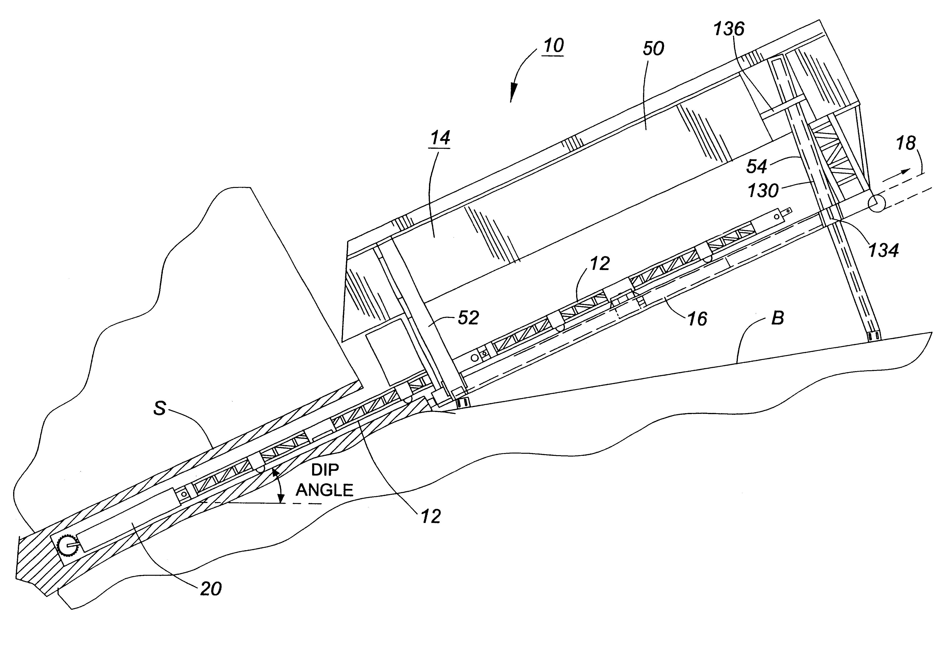
Schematic view of highwall miner

Slide 44
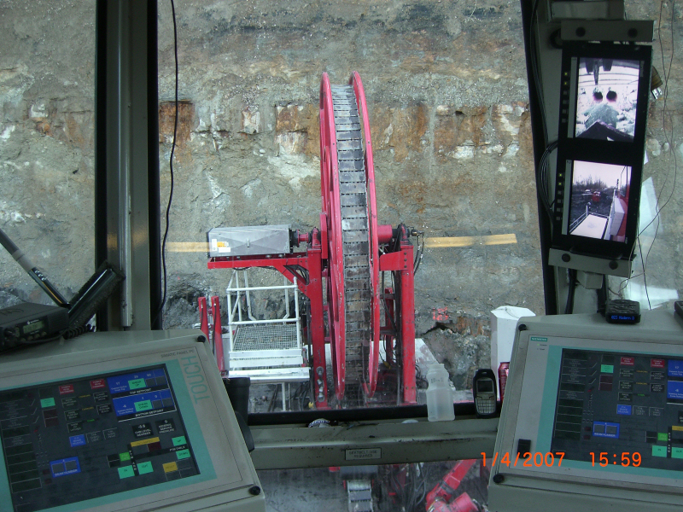

Slide 45
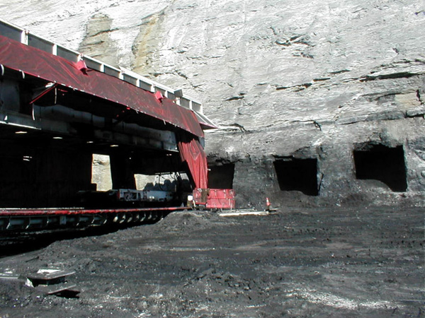

Slide 46
Auger Diameter Production requirement
30 inches 600 tons/shift
30 - 40 inches 600 - 1000 tons/shift
44 inches 1000 tons/shift

Slide 47
This method is amenable to relatively level lands and coal seam.
In practice, a series of parallel trenches would be progressively excavated across the mining property.
The coal between the trenches will be augered as the excavation proceeds.

Slide 48
Process of working
The process begins with coal being extracted from a reserve situated well beyond the reach of conventional surface mining methods. A standard highwall miner or mining system (HWM) involves boring usually a rectangular shaped entry or section out of an exposed highwall seam by remote control. Advanced highwall mining systems such as the Bucyrus - SHM are self-contained, hudraulically-powered tracked mobile units with electric drive. The Bucyrus - SHM highwall mining (1997) where the first HWM units that could mine parallel entries of a coal seams with a thickness ranging from 30 inches (76 cm) to 16 feet (5 m) to pre-determined depths of up to 1,000 feet (305 m).

Slide 49
A cutterhead attached to a powerhead assembly with 20-foot (6-m) pushbeams is used to penetrate and bore into the coal seam. The mined coal is then transported back to the machine by two counter-rotating screw conveyor positioned inside the pushbeams. The conveyors feature a coupling system that allows each auger to drive the next auger. The Bucyrus - SHM system is highly efficient, with the capability of producing an output of 40,000 to 120,000 tons of coal per month, depending on the height of the actual coal seam. Another benefit of the system is that it is designed to handle even wet coal together with high water-inflow and work with laser gyro guiding systems.

